Slide 1

SCHOOL MANAGMENT SYSTEM

Slide 2
1-The data structures of the Project
The project consists of two mainly linked lists :
1-alpha_double linked list whose nodes are also double linked list representing sections of students
1.1- the nodes of Alpha_Double linked list are arranged like (s1\1,s1\2,s2\1,s3\1……..)
1.2- also the nodes of( sections nodes) are arranged alphabetically
1.3-the user has the access to create the sections of Alpha_Double linked list
2-score_double linked list whose nodes are also doulbe linked list representing classes of students
2.1-the classes nodes of this list are created automatically when the user update the score of any student in the class
2.2- thr nodes of this classes are arranged according GPA

Slide 3
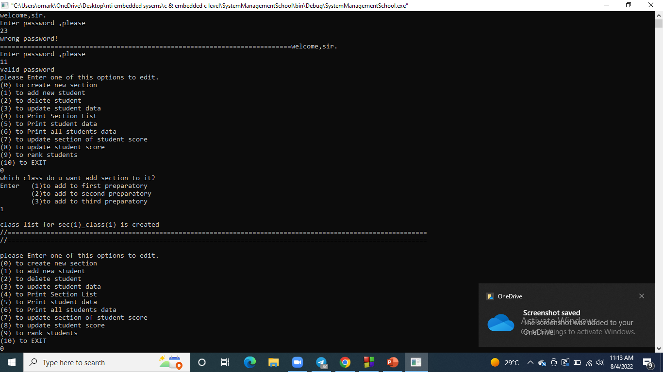
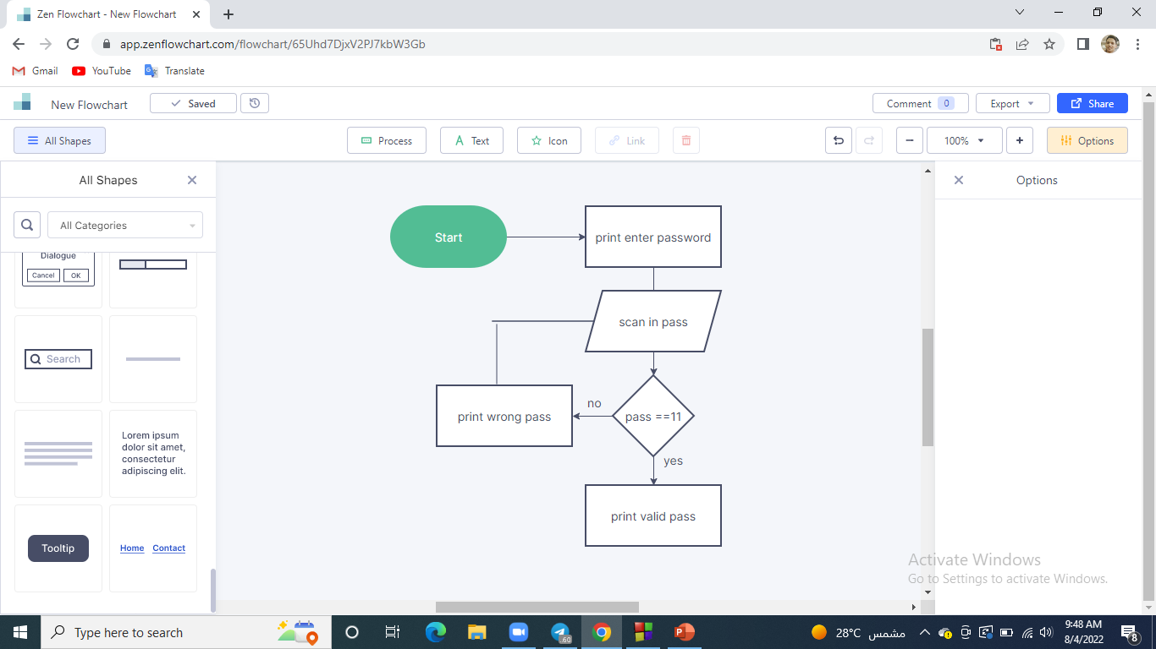
1. Init function:
2 – Some of The functions of the project

Slide 4
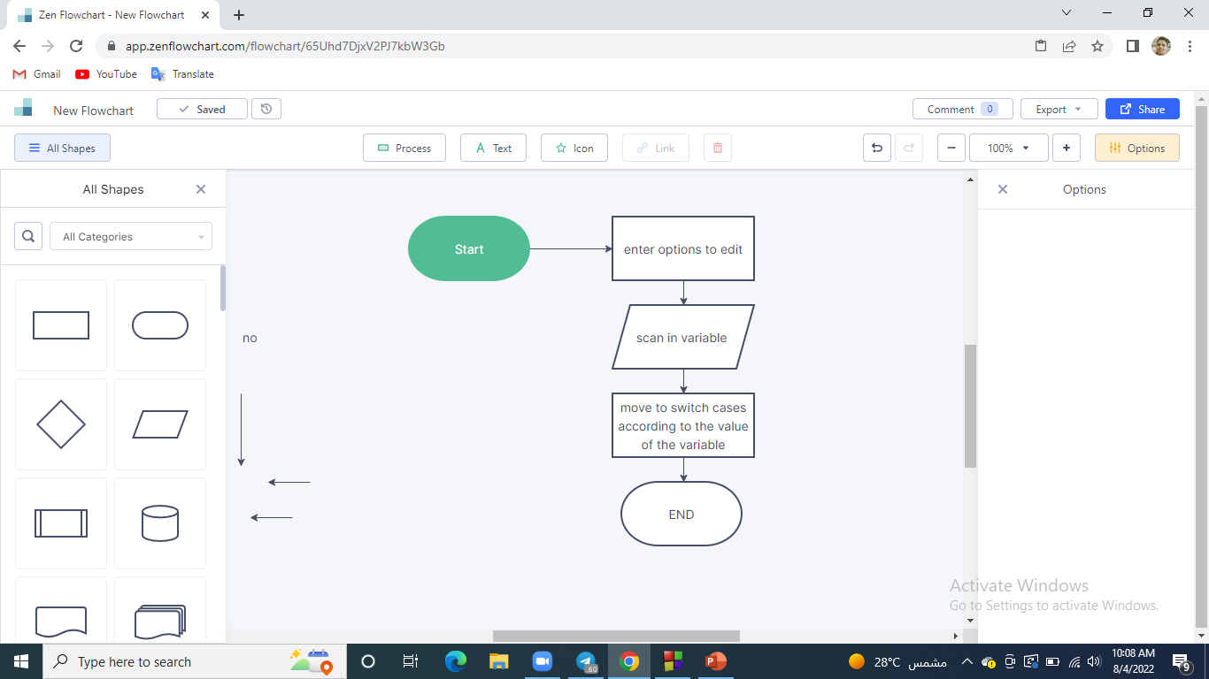
2.Select_what_to_edit() :
2 - Some of The functions of the project

Slide 5
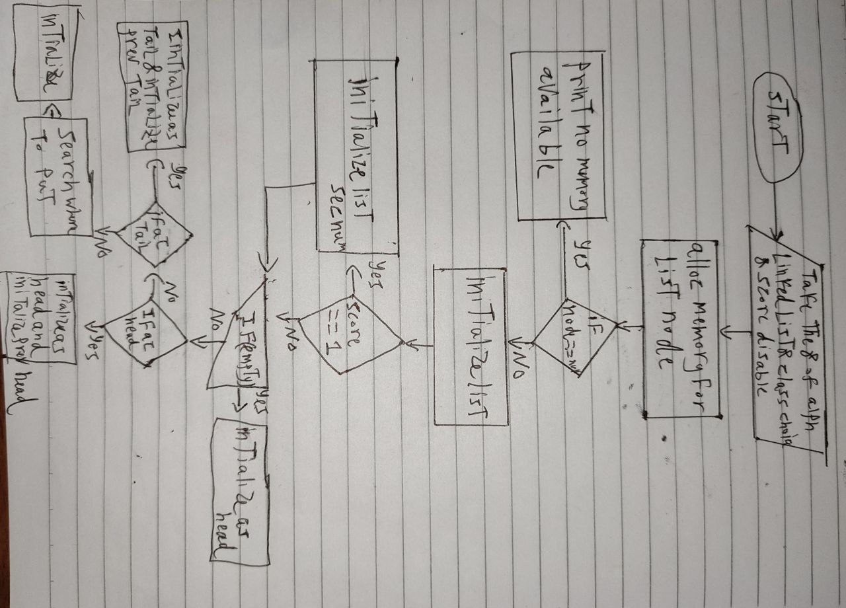
3. Create_ListOfClasses_list:
2- Some of The functions of the project

Slide 6
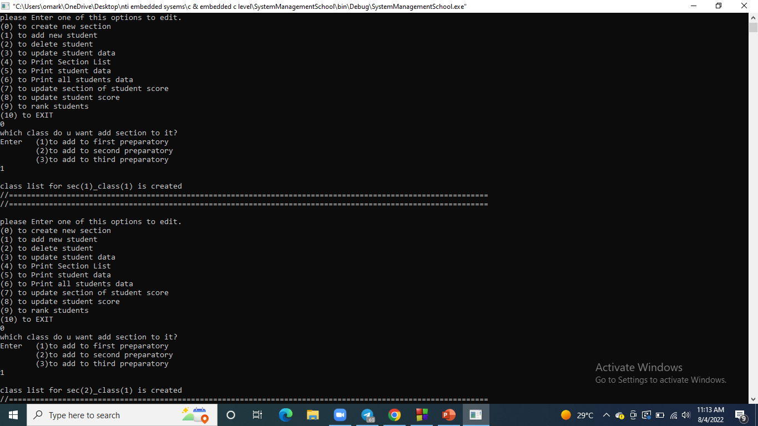
3- code options explanation with snap shots
1.Create class option :

Slide 7
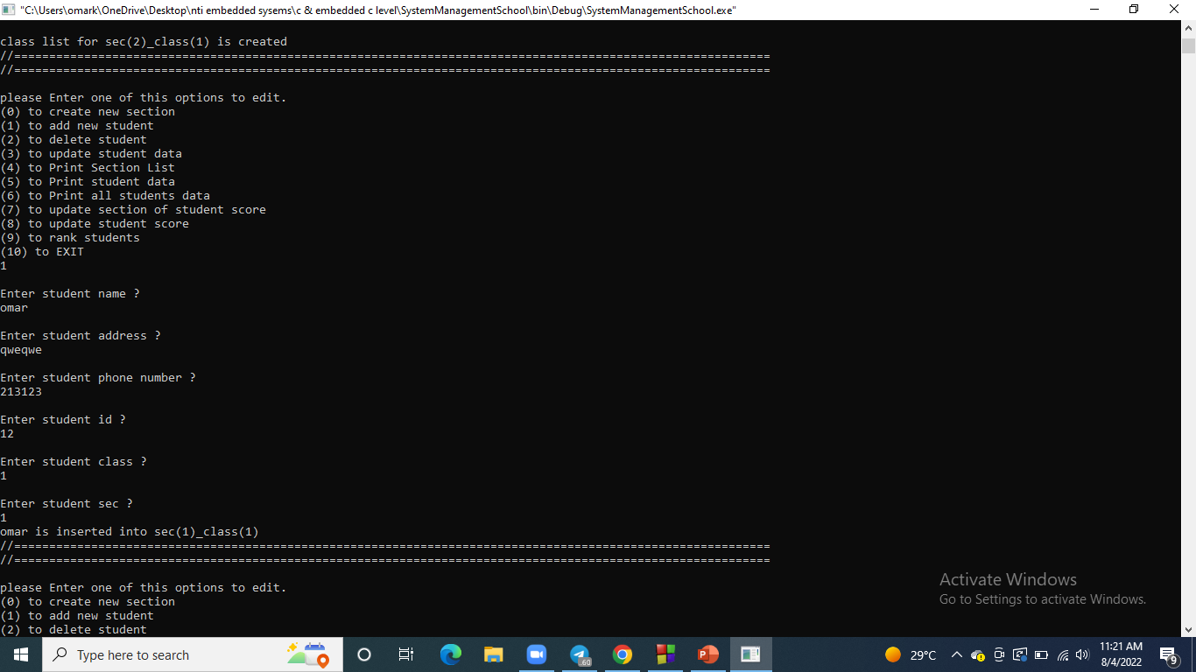
3- code switches explanation with snap shots
1.Add new student option :

Slide 8
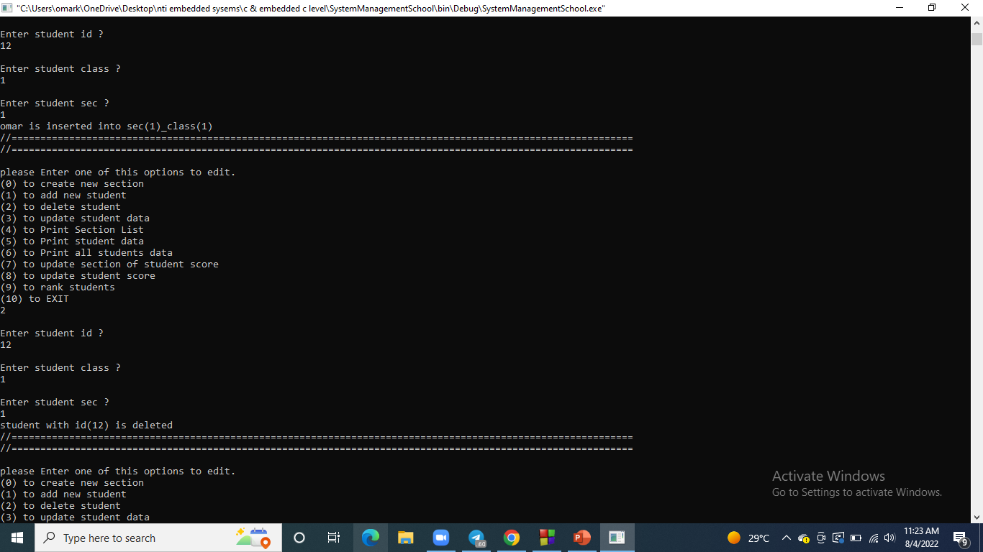
3- code switches explanation with snap shots
3. Delete student option :

Slide 9
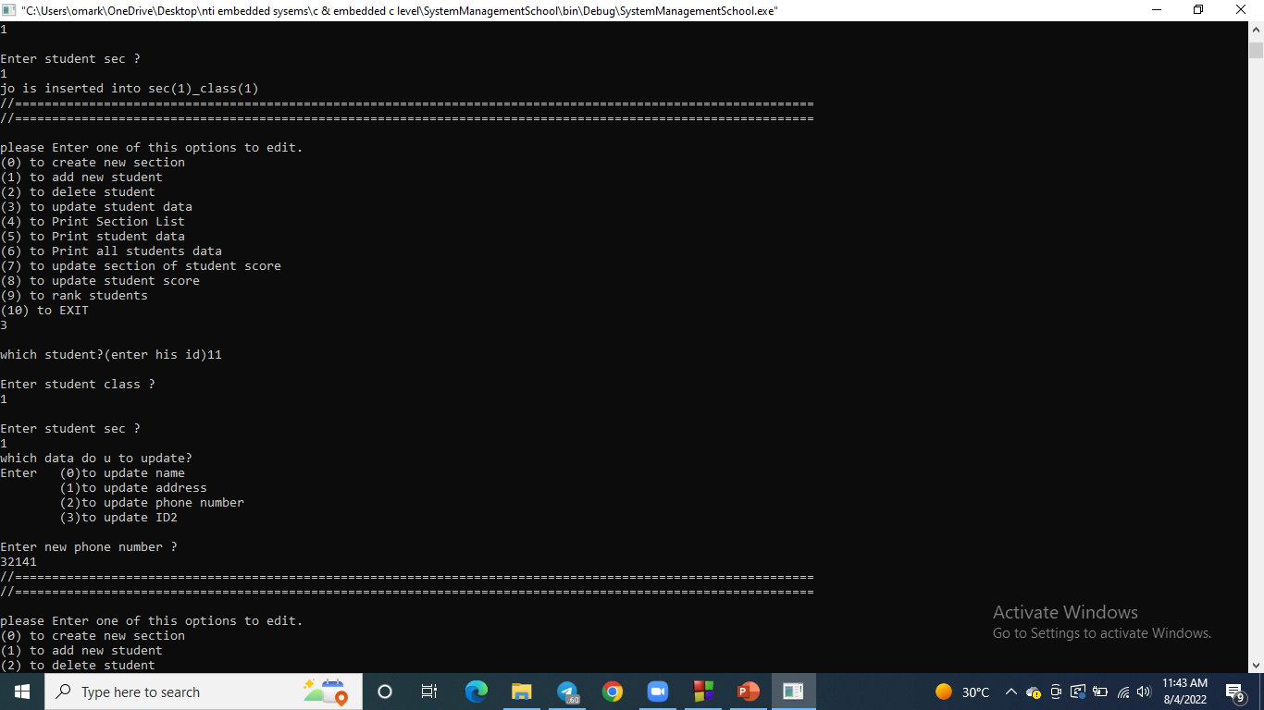
3- code switches explanation with snap shots
4.Update student data :

Slide 10
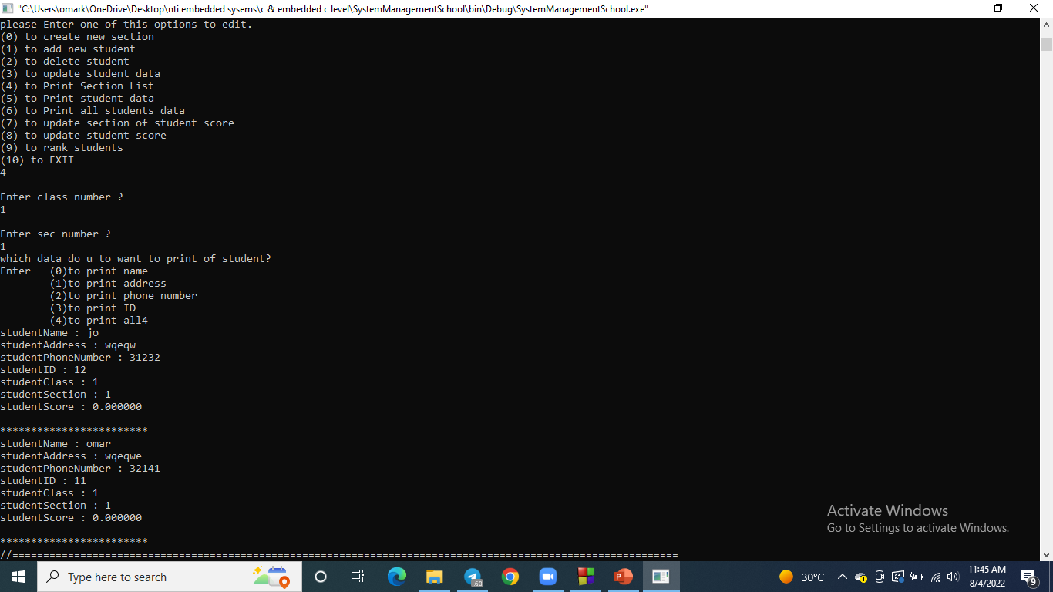
3- code switches explanation with snap shots
5.Print section list :

Slide 11
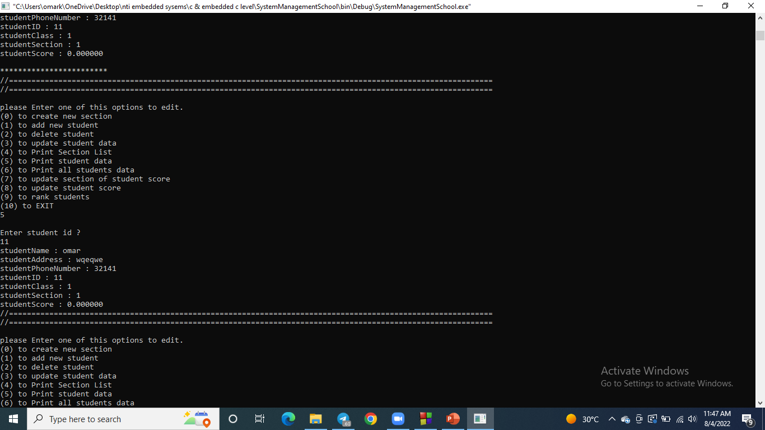
3- code switches explanation with snap shots
6.Print student data :

Slide 12
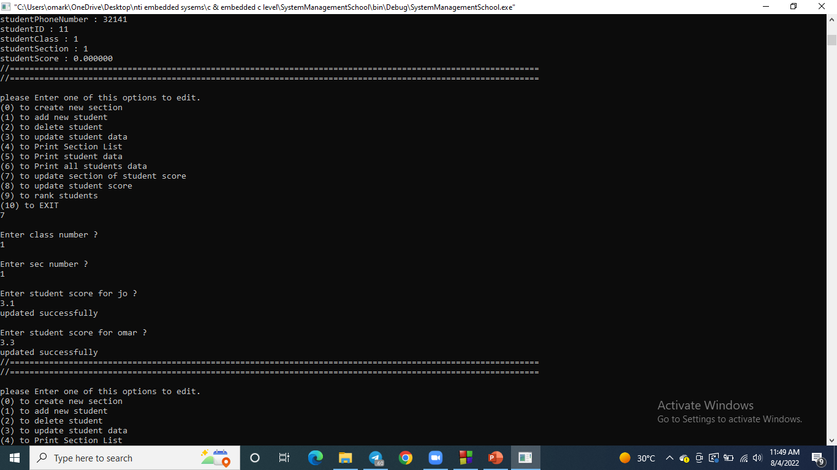
3- code switches explanation with snap shots
7.Update section_of_student score :

Slide 13
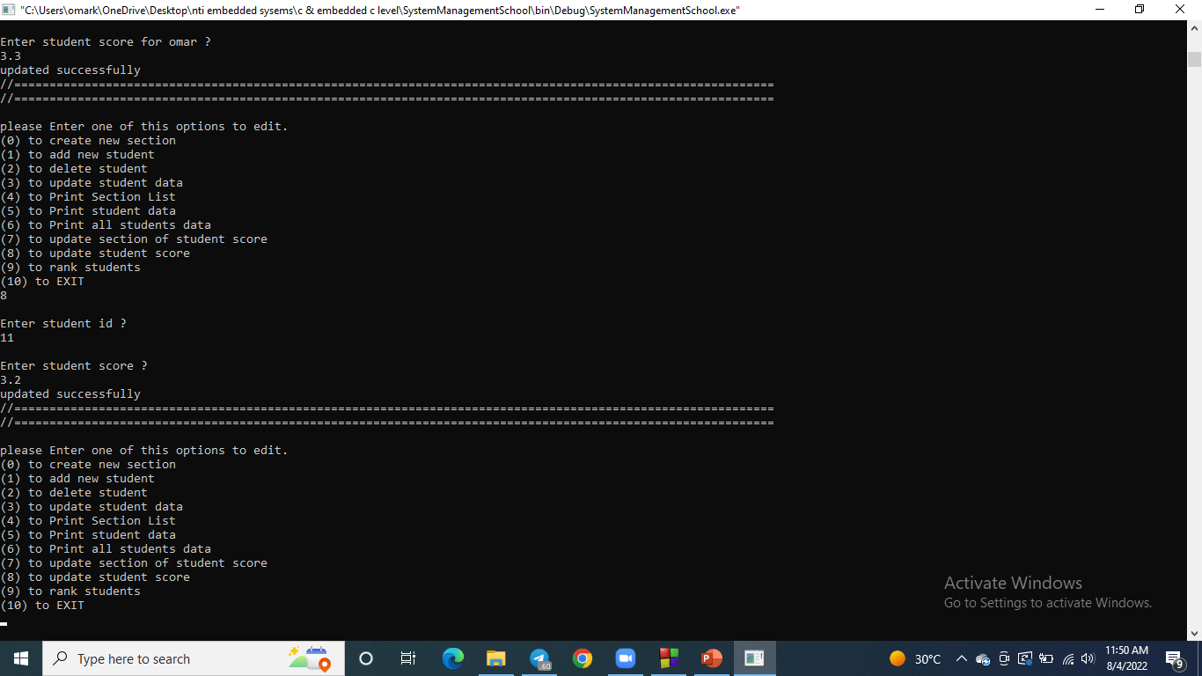
3- code switches explanation with snap shots
8.Update student score :

Slide 14
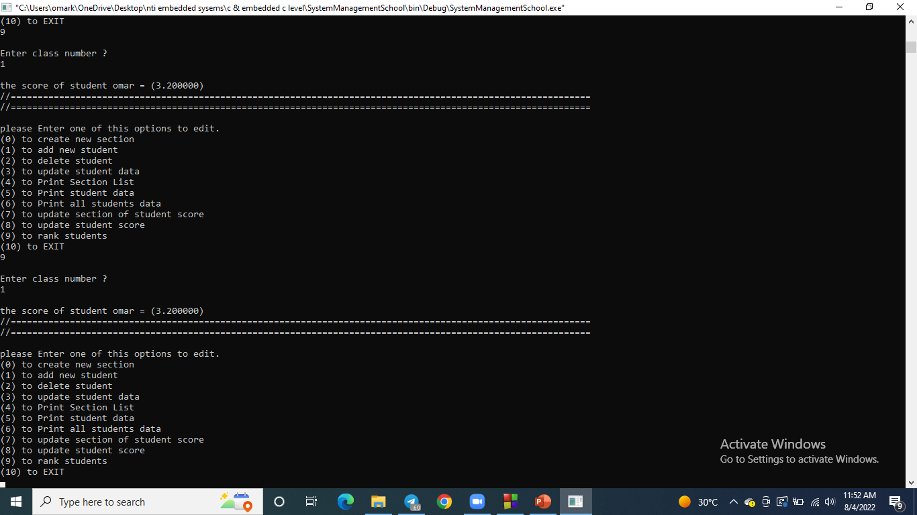
3- code switches explanation with snap shots
9.Rank students:

Slide 15
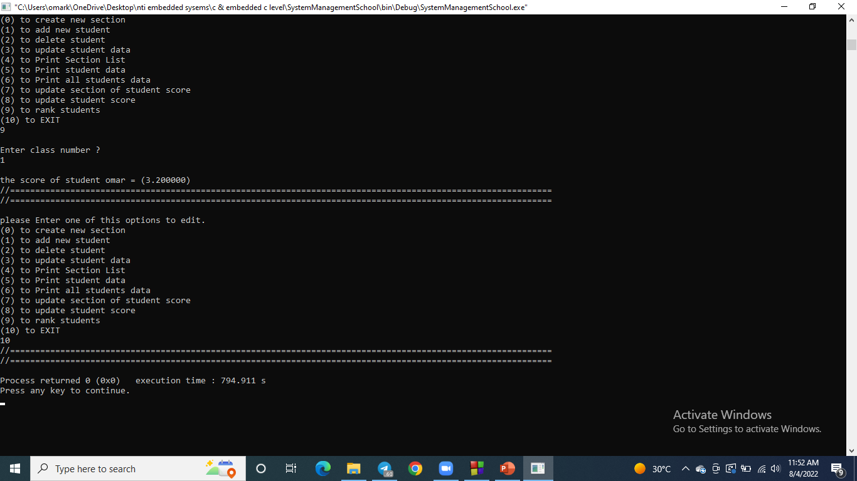
3- code switches explanation with snap shots
10.Exit:

Slide 16
Thanks!
ANY QUESTIONS?

